Slide 1



Job Recommendation System
By Group 5:
Arjun S Nair – KNP24AD017
Akshay K Sasi– KNP24AD010
Muhammed Raihan– KNP24AD035
Abhishek S– KNP24AD002

Slide 2
Table of Contents
Project Objective
Problem & Solution
Data Collection, Data Overview
Data Cleaning, Feature Engineering
Feature Selection
Exploratory Data Analysis
ML Model, Algorithms
Hardware and Software Requirements
Conclusion
Reference

Slide 3
Project Objective
To build an intelligent job recommendation system using Random Forest algorithms to match AI and data science job opportunities with user skills, while performing comprehensive exploratory data analysis on 700+ job postings from Kaggle's 2025 AI/Data fields dataset.

Slide 4
Problem Statement
Job seekers in AI/IT face significant barriers: skill-job mismatches create confusion, inefficient career planning delays opportunity identification, and lack of skill gap visibility prevents strategic upskilling. Can we implement a ML-Based Job Recommender given the dataset of job posts in that field.
Solution
A skill-based recommendation engine that maps user-entered skills to matching AI/IT roles, highlights missing competencies, suggests salary ranges by skill combination, and provides actionable career guidance through an intuitive interface.

Slide 5
Data Collection
Sourced 700+ AI jobs dataset from Kaggle containing job titles, descriptions, companies, locations, ratings, and salary information
URL: 700+ AI jobs data | 2025 Kaggle Dataset
Skills and Skill Category data obtained from online skill taxonomies and LinkedIn posts –
URL: Lightcast Skill Taxonomy

Slide 6
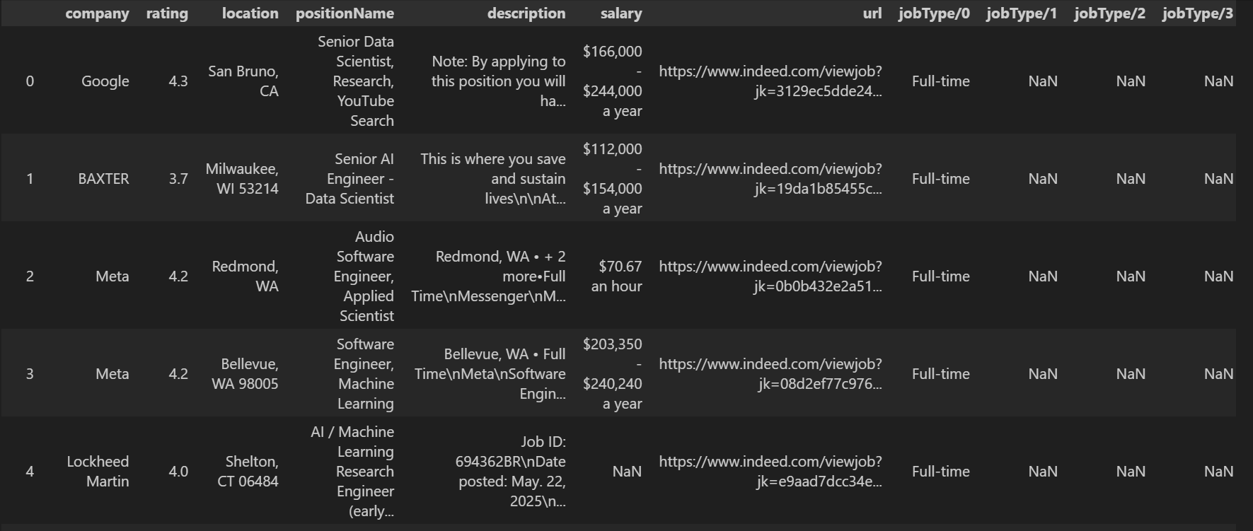
Data Overview
The Dataset has the following features:
Position Name, Company, Location, Company Rating, Job Type (e.g., Full-time, Internship), Salary (if available), External Application Links, Full Job Descriptions
Most Important feature for our project – Description Column

Slide 7
Data Cleaning
Removed unnecessary features like: ‘url','jobType/0','jobType/1','jobType/2','jobType/3’,‘externalApplyLink','searchInput/country','searchInput/position’ due to them mostly having null values and not contributing to the project.
Parsed Salary by splitting the salary column into min_salary and max_salary then calculated its average using parse_salary()
Imputed Missing Salary Values with Random Forest Regressor after encoding company, position, city features to be used as features to predict missing values

Slide 8
Feature Engineering
Engineered features from job descriptions using text extracting functions that use skills and skills category dictionaries made using online taxonomies, job descriptions, LinkedIn data, LLMs and. Skills vectorized based on dictionary key indices to be used for machine Learning
skills_dict, skill_categories are skill dictionaries
extract_skills_with_categories, count_skills, extract_skills functions are used to create the new features

Slide 9
Feature selection
Features for Classification:
Text Features:
- Skills text processed via TF-IDF (100 most important terms)
- Includes unigrams and bigrams (e.g., "machine_learning")
Numeric Features:
- Company encoding (company_encoded)
- Location encoding (city_encoded)
- Skills metrics (total_skills, skills_count_all)
- Salary information (min_salary, max_salary, average_salary)
- Title indicators (has_scientist, has_engineer, has_analyst, has_architect, has_research)

Slide 10
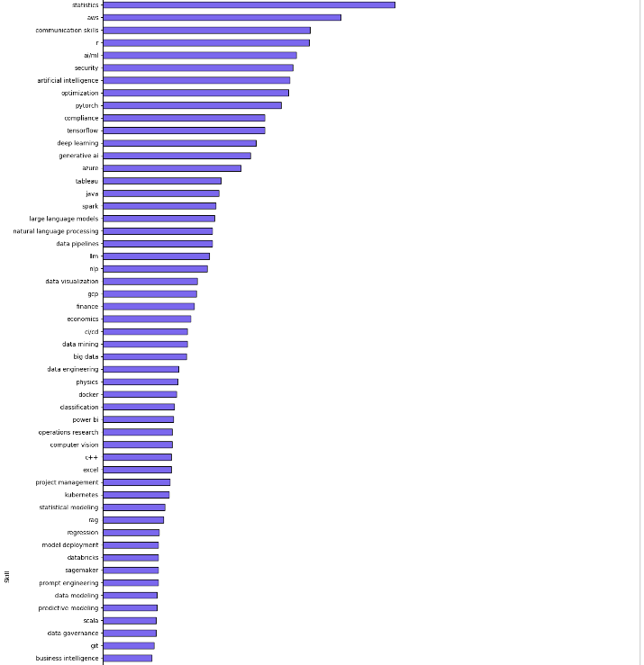
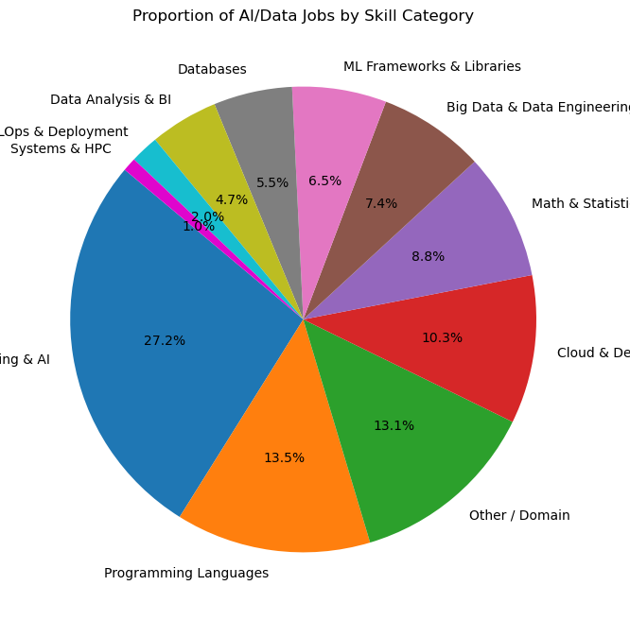
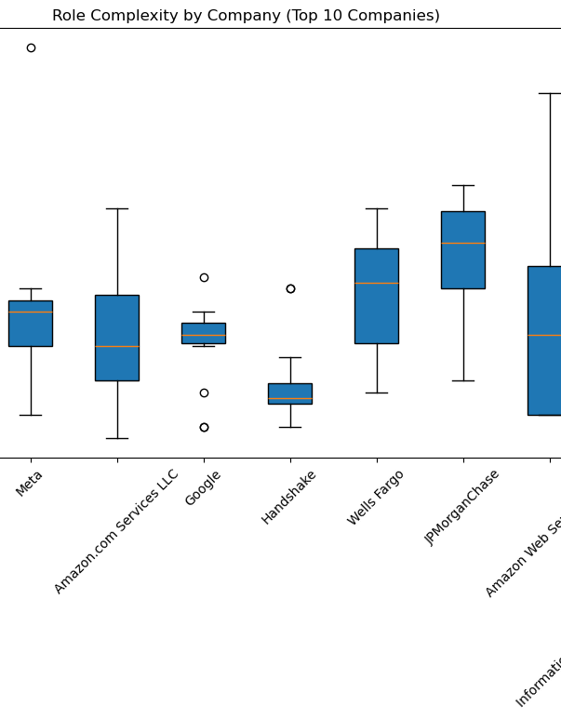
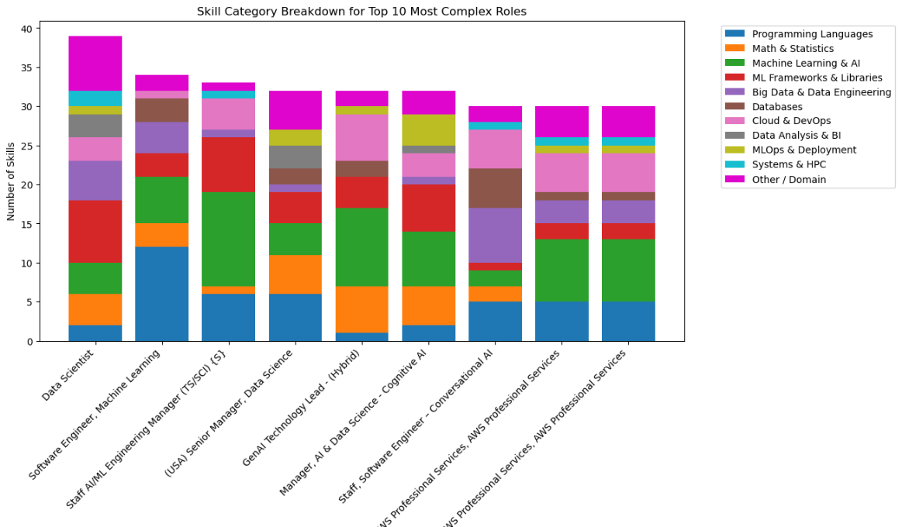
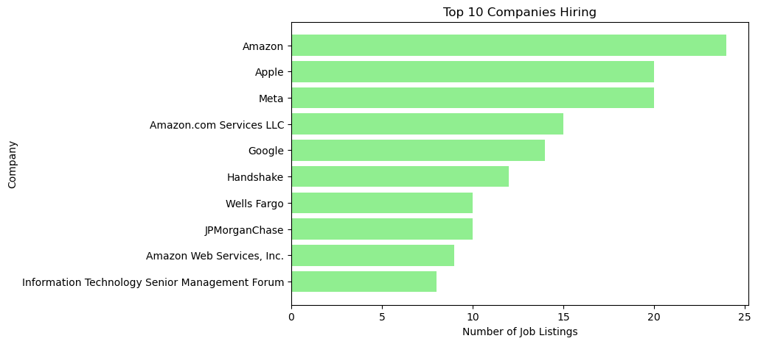
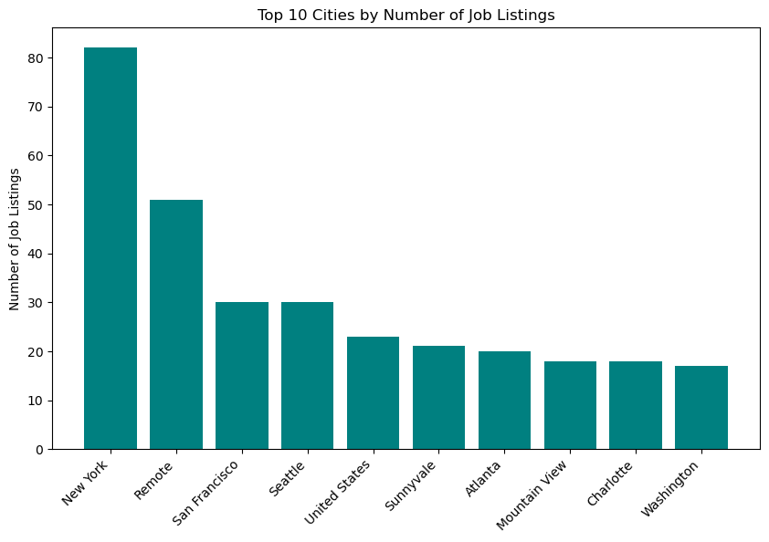
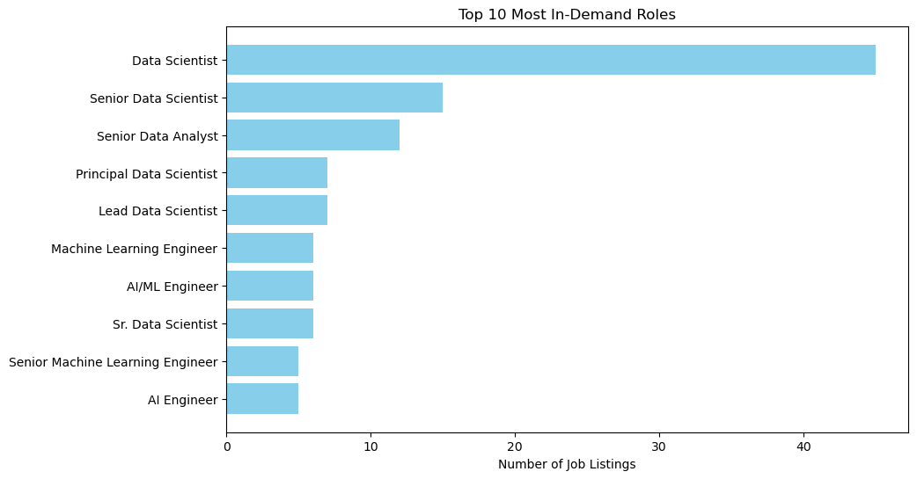
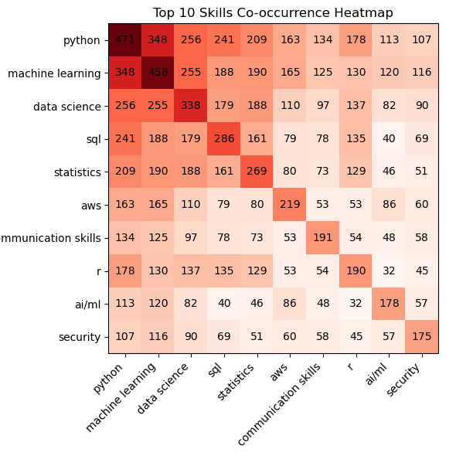
EDA - Skill and Market Trends Analysis

Slide 11

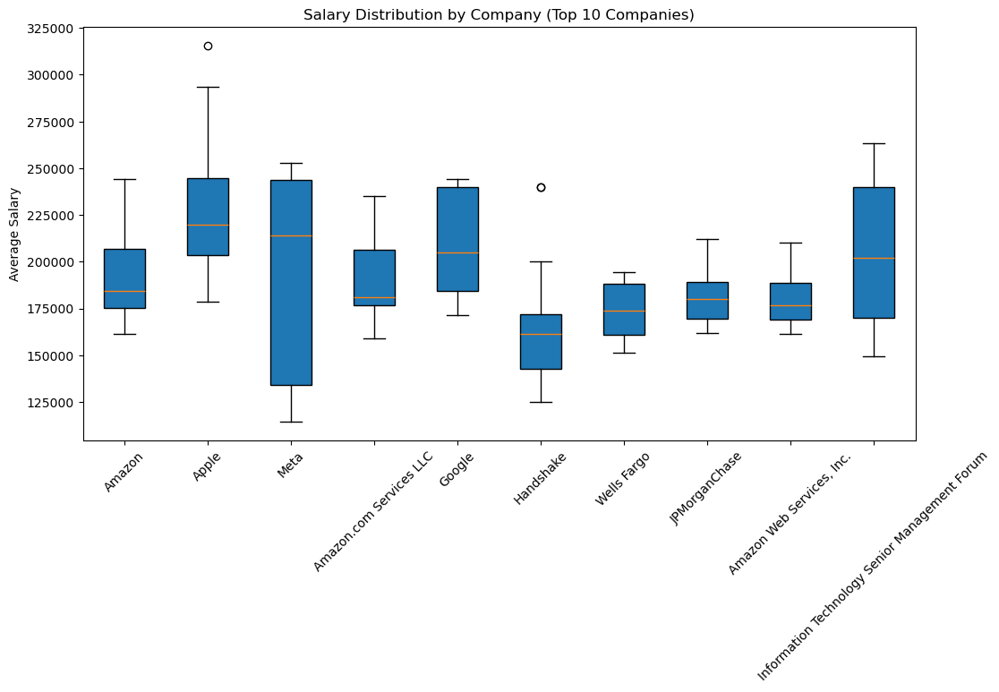
Skills Analysis and Salary Distribution

Slide 12
Insights From EDA
Skill Demand Analysis
Python dominates as the #1 required skill (471 listings), followed by Machine Learning (458) and SQL
Technical skills prevail - 7 of top 10 skills are technical (Python, ML, SQL, AWS, R, AI/ML, Statistics)
Surprising soft skill inclusion - Communication Skills ranks #7, showing growing importance of business alignment
Market Trends & Opportunities
Data Scientist is most in-demand role (45 listings), with Senior Data Scientist at #2, Senior Data Analyst at #3
Tech giants lead hiring - Amazon, Apple, Meta, Google account for majority of listings

Slide 13
Insights From EDA
Geographic concentration - New York, Remote, San Francisco, Seattle are top locations
High-value skill combinations - Python + ML + SQL + AWS form core competency cluster
Role Complexity & Compensation
Complex roles require 30+ diverse skills across multiple categories
Programming Languages (27.2%) and Machine Learning & AI (13.5%) dominate skill requirements
Domain expertise matters - "Other/Domain" skills represent 10.3% of requirements
Salary correlates with skill diversity - companies offering higher salaries demand broader skill sets

Slide 14
Insights From EDA
Strategic Career Implications
Full-stack data professionals are most sought-after - technical skills alone are insufficient
Cloud expertise (AWS) is becoming mandatory alongside core data skills
Communication skills differentiate candidates in competitive market
Specialized AI/ML roles are emerging as distinct career paths beyond general data science
Bottom Line: Success requires balanced mastery of programming, ML fundamentals, cloud platforms, and business communication skills.

Slide 15
Salary Predictor Model
Random Forest Regressor: Salary prediction & imputation
Training Data: Enhanced jobs dataset with salary features
Target Variable: position_category` (Multi-class: 10 AI/ML job types)
Use: Automatically categorize job postings into standardized position types
Input Variables: min_salary, max_salary, average_salary
Type: Continuous numerical values
Use: Predict earnings potential and fill missing salary data
Features Classification: High-skill match detection

Slide 16
Algorithm: Random Forest
An ensemble machine learning method that operates by constructing multiple decision trees during training and outputting the class that is the mode of the classes of the individual trees. It introduces randomness through bagging (bootstrap aggregating) and feature randomness to create a diverse set of trees, resulting in improved accuracy and robustness against overfitting compared to single decision trees. We employed a Random Forest classifier for this job classification task due to its ability to handle mixed data types (text features from TF-IDF and numerical features like salary), resistance to overfitting, and built-in feature importance analysis. The ensemble approach of multiple decision trees voting on the final classification proved particularly effective for our multi-class problem with 10 distinct job categories.
- Why chosen: Excellent for mixed data types & multi-class classification
- Key benefit: Reduces overfitting through collective tree voting
- Our results: 83.7% accuracy across 10 job categories

Slide 17
Classifier Model
Training Data: Enhanced jobs dataset with skills, company, and salary features
Classification: Job Position Categorization
Input Variables:
‘skills’ feature (converted to numerical features using TF-IDF text processing),
numerical features:- 'company_encoded', 'city_encoded', 'total_skills', 'skills_count_all', 'min_salary', 'max_salary', 'average_salary',
'has_scientist', 'has_engineer', 'has_analyst', 'has_architect', 'has_research’
Target Variable: position_category` (Multi-class: 10 AI/ML job types)
Categories: Data Scientist, AI Engineer, Machine Learning Engineer, AI/ML Leadership, Data Analyst, Research Scientist, AI Architect, Generative AI Specialist, Data Engineer, Software Engineer - AI/ML
Use: Automatically categorize job postings into standardized position types

Slide 18
Results
83.7%
84.8%
83.7%
Overall Accuracy
Precision
Recall
Correctly classifies job matches in 83.7 % of cases
When recommending, 84.8 % accuracy confirmed
Successfully identifies 83.7 % of true matches
82.5%
F1-Score
Balance between precision and recall

Slide 19
Technical Requirements
Hardware
Software
Minimum System Requirements
Intel Core i3+ or AMD Ryzen 3+, 4GB RAM, 10MB disk space, GPU optional
Local Stack
Python 3.11.13, Scikit-learn 1.6.1, pandas, NumPy, matplotlib
Version Control
Google Colab for notebook, Git/GitHub for project repo
User Access
Any IDE (VSCode), and install locally via pip install requirements.txt

Slide 20
Conclusion
Developed a job position classifier achieving 83.7% accuracy with comprehensive evaluation metrics, providing a foundation for job recommendation systems targeting AI and data science career paths.
Real-World Impact: Solves critical career planning challenges affecting thousands of job seekers in the AI/ML industry
ML-Driven Solution: Leverages Random Forest classification with TF-IDF text processing and feature engineering
Future Roadmap: Resume parser integration, improved UI, expanded dataset across regions and domains, enhanced NLP tokenization

Slide 21
References & Resources
Research Foundation: Job Recommendation Systems using Content-Based and Collaborative Filtering
URL: ResearchGate Paper

Slide 22
THANK YOU

